Slide 1

Instructions
This document is the template for presentations of the department LS³ following the new corporate design of the University of Stuttgart.
The first section shows a sample of the English slides and the second section shows a sample of the German slides.
The colors to be used are Anthrazit, Mittelblau and Hellblau. Gradients go from Mittelblau to Hellblau diagonally from the lower-left to the upper-right corners.

Slide 2


Title
Authors

Slide 3
Title of chapter
Chapter 1/1

Slide 4
Title of content slide
Subtitle
Level 1
Level 2

Slide 5






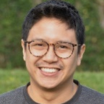




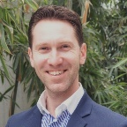




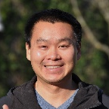


Thank you Name mail@iws.uni-stuttgart.de iws-ls3.uni-stuttgart.de Acknowledgments We thank the DFG for financial support of this research
Stochastic Simulation and Safety Research for Hydrosystems (LS³)

Slide 6


Thank you!
Name
mail@iws.uni-stuttgart.de
University of Stuttgart
Stochastic Simulation and Safety Research for Hydrosystems (LS³)
iws-ls3.uni-stuttgart.de

Slide 7
Titel
Namen

Slide 8
Titel vom Kapitel
Kapitel 1/1

Slide 9
Title of content slide
Subtitle
Level 1
Level 2

Slide 10
Vielen Dank Name mail@iws.uni-stuttgart.de iws-ls3.uni-stuttgart.de Danksagung Wir danken…
Stochastische Simulation und Sicherheitsforschung für Hydrosysteme (LS³)

Slide 11

Vielen Dank!
Name
mail@iws.uni-stuttgart.de
Universität Stuttgart
Stochastische Simulation und Sicherheitsforschung für Hydrosysteme (LS³)
iws-ls3.uni-stuttgart.de

